Slide 1

Lending Club Case Study
Mohan
Anitha

Slide 2
Overview
Introduction: Lending club is an established peer to peer lending company that has been facilitating loans since 2007. It serves as a bridge between investor seeking profitable opportunities and individuals requiring financial assistance.
Role of Lending: Acting as an intermediary, Lending Club not only simplifies the process of acquiring loans for individuals but also ensures that all loan applications are thoroughly verified before categorizing applicants into various grades based on their creditworthiness.

Slide 3
Problem statement
Aim: The primary aim of our analysis is to detect patterns that would help in predicting whether a potential loan might default.
Objective: Our objective is to meticulously analyze both the information available at the time of application to pinpoint key indicators of default
Approach: We employed rigorous Exploratory Data Analysis (EDA) techniques, utilizing tools and methods in risk analytics to minimize financial risk and improve decision-making processes for our clients.

Slide 4
Business Understanding
The business objective is to take a decision whenever they receive a loan application whether to reject or approve based on certain variables.
The data contains information about past loan applicants and whether they defaulted or not. Data has details regarding approved loan not the rejected ones. It has 3 status of loan which is fully paid, current and charged off.

Slide 5
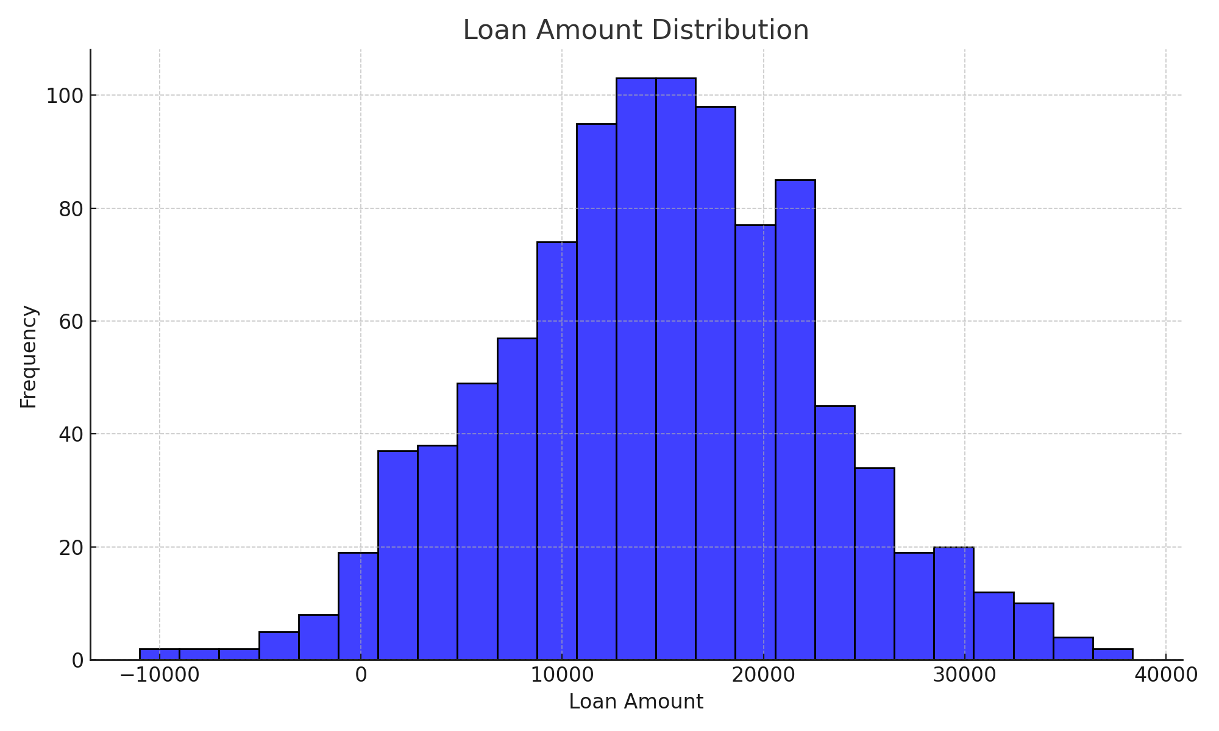
Loan amount distribution
This histogram shows the distribution of loan amounts, which is essential for understanding the range most borrowers opt for. The distribution appears right-skewed, indicating a higher frequency of lower loan amounts

Slide 6
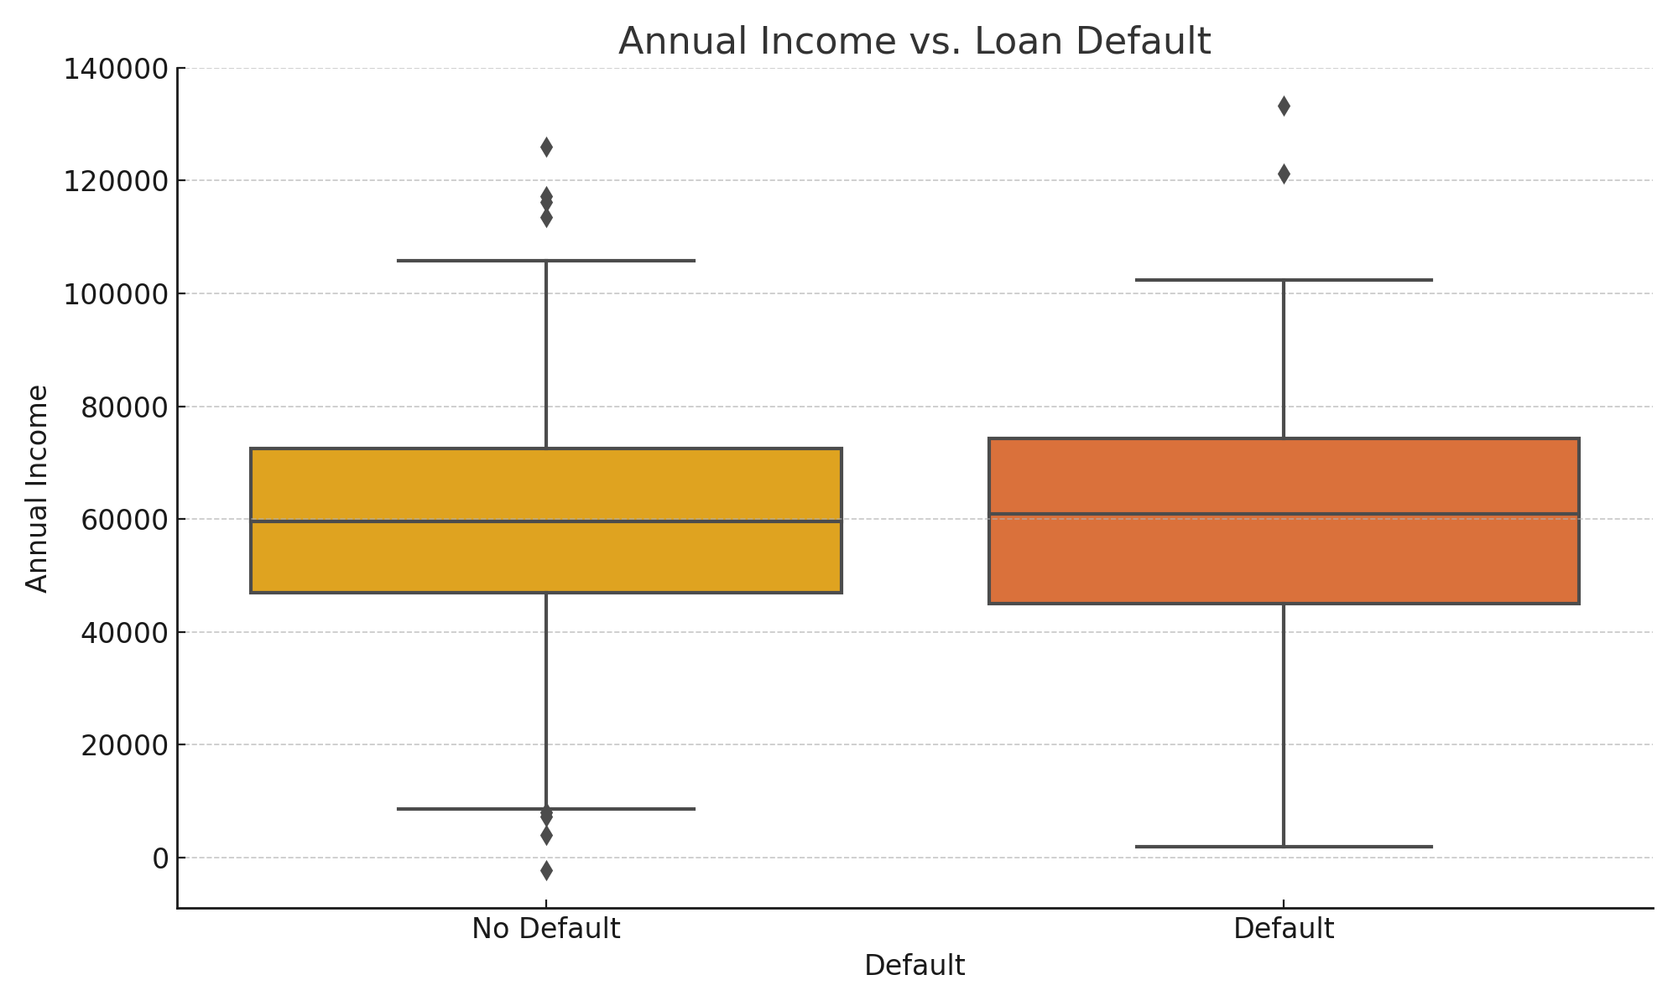
Annual Income vs. Loan Default
This boxplot compares the loan amounts between defaulted and non-defaulted loans. It's evident that higher loan amounts are slightly more prone to default, possibly indicating higher financial risk.

Slide 7
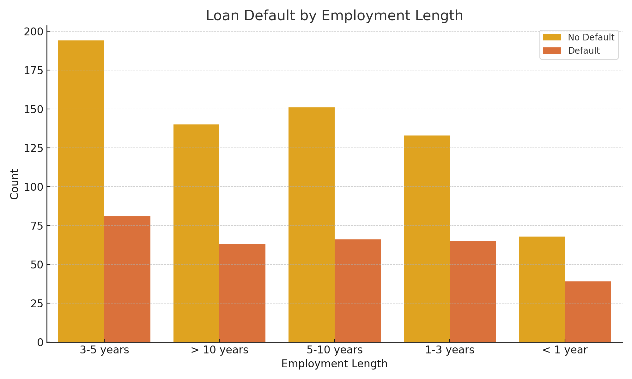
Loan Default by Employment Length

Slide 8
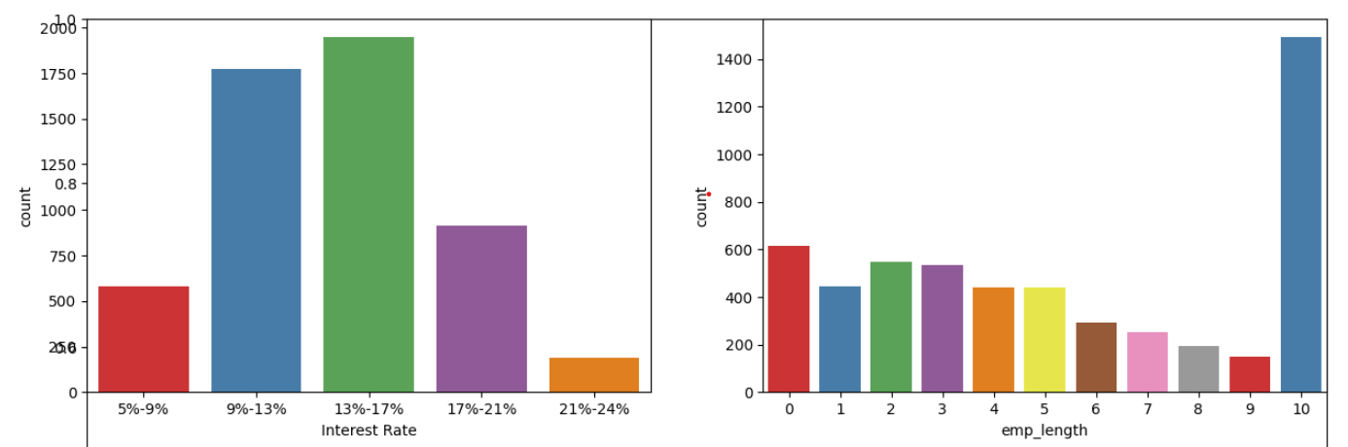
Employee length and Interest Rate
Interest Rate: The count of loan taken varies with interest rate showing peak around in 5-15 bracket and decreasing slowly where as the chance of defaulting increases with interest rate.

Slide 9
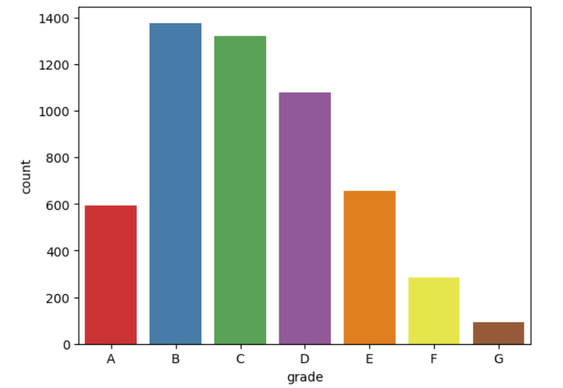
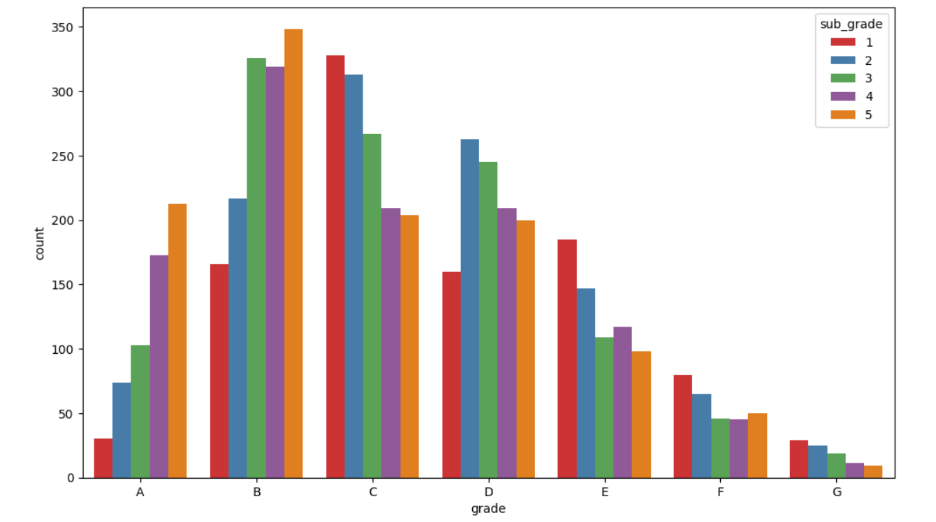
Grade vs sub grade
Grade: The loan approved are majorly of higher grade as they are of low risk thus low chance of defaulting.
60 month term loans have larger number of lower grade loans with high risk.
Sub Grade: This provides more insight that the loans within grade are more skewed towards lowered sub grades.

Slide 10
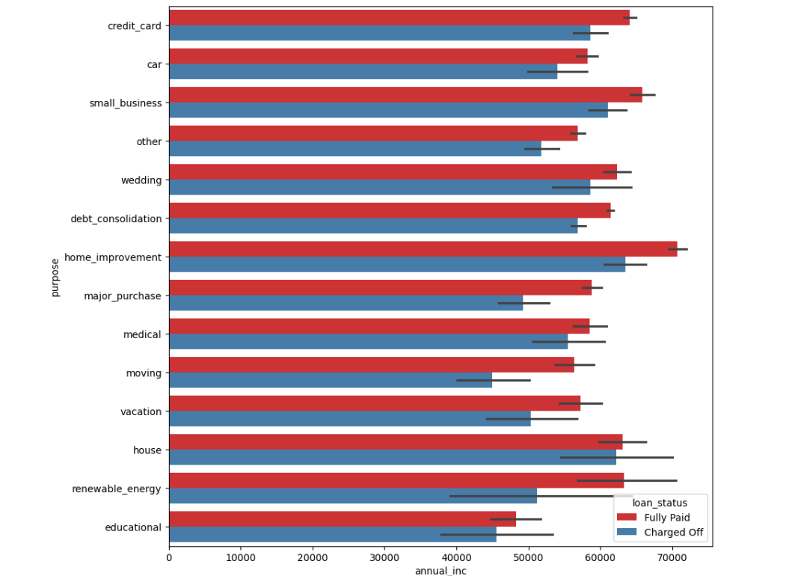
Annual income vs loan purpose

Slide 11
Parameters for defaulting
Applicants taking loan for 'home improvement' and have income of 60k -70k
Applicants whose home ownership is 'MORTGAGE and have income of 60-70k
Applicants who receive interest at the rate of 21-24% and have an income of 70k-80k
Applicants who have taken a loan in the range 30k - 35k and are charged interest rate of 15-17.5 %
Applicants who have taken a loan for small business and the loan amount is greater than 14k
Applicants whose home ownership is 'MORTGAGE and have loan of 14-16k
When grade is F and loan amount is between 15k-20k
When employment length is 10yrs and loan amount is 12k-14k
When the loan is verified and loan amount is above 16k20. For grade G and interest rate above 20%

Slide 12
Recommendations
Home Improvement Loans with Income of 60k - 70k:
Offer personalized financial planning assistance to help borrowers understand the long-term implications of their loans.
Implement pre-loan counseling sessions to ensure borrowers are aware of their repayment capabilities.
Mortgage Holders with Income of 60k - 70k:
Develop targeted risk assessment models that take into account the total debt-to-income ratio before approving loans.
Increase oversight on loans to applicants in this income bracket, possibly requiring additional collateral or co-signers.
High Interest Rates (21-24%) with Income of 70k - 80k:
Restructure interest rates based on timely repayment behavior to incentivize borrowers to make payments on time.
Provide options for refinancing at lower interest rates after a period of consistent on-time payments.
Loans of 30k - 35k with Interest Rates of 15-17.5%:
Introduce tiered interest rates that decrease over the life of the loan as a reward for consistent repayments.
Offer financial incentives for early repayment or for making larger than minimum payments.
Small Business Loans Greater Than 14k:
Enhance due diligence processes to better assess the viability of the businesses applying for loans.
Create support programs that provide business advice and guidance to reduce the risk of default.

Slide 13
Recommendations
Mortgage Holders with Loans of 14k - 16k:
Provide mortgage holders with access to financial advisory services to better manage their overall debt.
Consider shorter loan terms with manageable installments to prevent long-term financial strain.
Grade F Loans Between 15k and 20k:
Require more stringent underwriting standards for loans with lower grades to minimize risk.
Offer structured repayment plans that can adjust according to changes in the borrower's financial situation.
10-Year Employment Length with Loans of 12k - 14k:
Verify stability and history of employment more rigorously to ensure reliability of the income sources.
Offer lower interest rates to applicants with longer employment histories and good credit histories to reflect their lower risk.
Verified Loans Above 16k:
Implement ongoing monitoring and periodic re-assessment of the borrower’s financial health throughout the loan term.
Encourage regular communication with the borrower to catch early signs of financial distress.
Grade G and Interest Rates Above 20%:
Avoid offering high-interest loans to low-grade borrowers unless there are clear, manageable paths to improving their credit standings.
Implement financial education programs aimed at helping borrowers in these categories to understand and manage their debts better.

